Slide 1
CS 447/647
Software Management

Slide 2
Overview
What is required for a network-based installation?
What is a high-level package manager? (Know Debian + RHEL)
What is a low-level package manager? (Know Debian + RHEL)
What is Debian?
How is a .deb package structured?

Slide 3
Installation
Many different Methods
Media - Easiest but doesn’t scale
USB
CDROM
DVD
Network - Scales but requires development
PXE, iPXE more likely
TFTP
DHCP
PXE Kernel
PXE Menu
chroot - Specialized
Virtual Machines
Containers

Slide 4
Installation - Media
wget \ https://mirrors.ocf.berkeley.edu/ubuntu-releases/24.04.2/ubuntu-24.04.2-desktop-amd64.iso
dd if=ubuntu-24.04.2-desktop-amd64.iso of=/dev/sd[a-z] bs=1M
# or use a GUI UNetbootin, Rufus

Slide 5
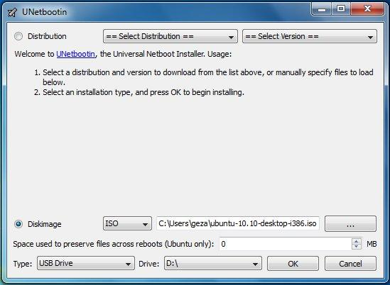
Installation - Media

Slide 6
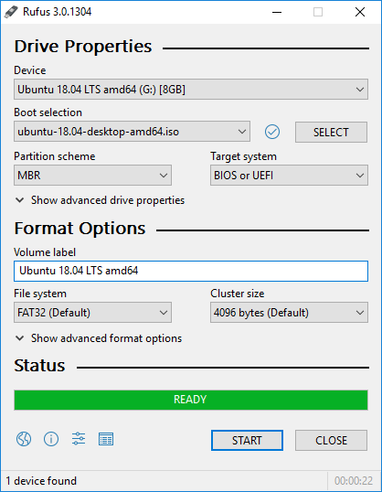
Installation - Media

Slide 7
Network

Slide 8
Network
Much more advanced than a media based installation
Requires
DHCP
iPXE - https://ipxe.org/
TFTP - Trivial File Transfer Protocol
Networking knowledge
Scripting and menu creation
HTTP (optional but likely)
Some open-source solutions
Cobbler
FOG Project (https://fogproject.org/)

Slide 9
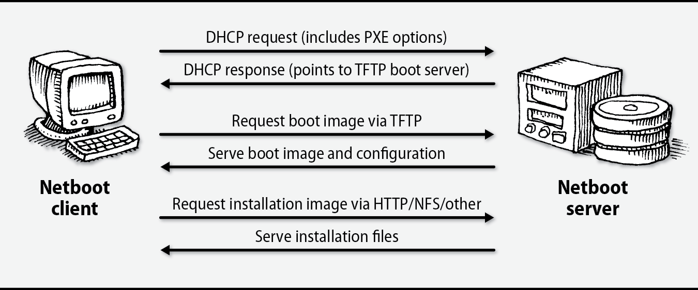
Network - PXE

Slide 10
Network - DHCP
Dynamic Host Control Protocol
RFC2131 - 1997
Provides a framework for passing configuration information to hosts on a TCP\IP network
UDP - User Datagram Packet Based
“DHCP in its current form is quite insecure.”
https://tools.ietf.org/html/rfc2131
Notes:
RFC2131 - DHCP passes configuration information including:
IP address, subnet, gateway, DNS server

Slide 11
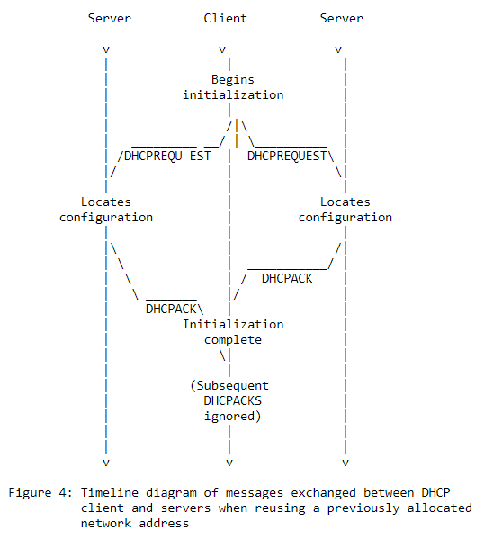

Slide 12
Network - DHCP Extensions
“Configuration parameters and other control information are carried in tagged data items that are stored in the 'options' field of the DHCP message.”
“Security issues are not discussed in this memo.”
RFC2132 - https://tools.ietf.org/html/rfc2132

Slide 13
Network - DHCP Extensions
3: Router 5: Name Server 6: DNS Server 9: LPR - Line Printer Remote protocol 12: Hostname 17: Root Path 51: IP Lease Time 66: TFTP server name 67: Bootfile name 61: Client-identifier - DHCP Client 190: Username 😲 191: Password 😲
RFC2939 https://ipxe.org/howto/dhcpd

Slide 14
Network - PXE
Two popular options
PXELINUX in SYSLINUX
iPXE (We use this)
Scripting
Proprietary Devices
TLS Authentication
The PXE kernel is stored in the TFTP server’s tftpboot directory
The DHCP Server points to
Server IP
Filename
The kernel loads a menu
PXELINUX - TFTP File
iPXE - TFTP File, HTTP URL, Script

Slide 15
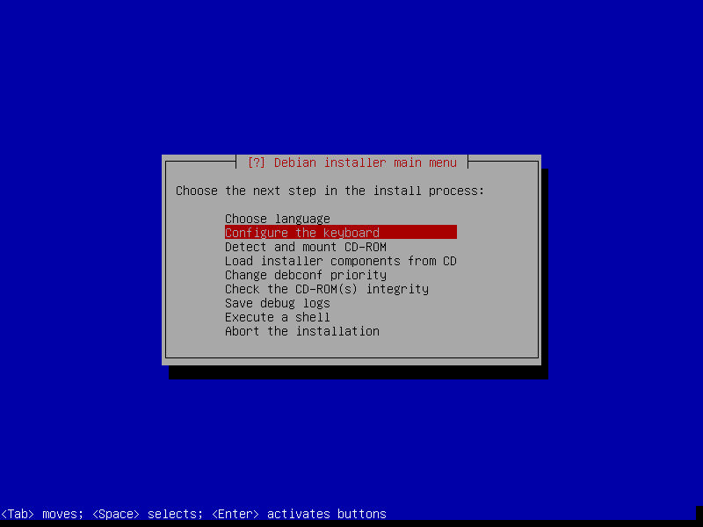

Slide 16
Network - PXE
# Debian preseed.cfg # https://www.debian.org/releases/buster/example-preseed.txt # Locale sets language and country. d-i debian-installer/locale string en_US
# Keyboard selection. d-i console-setup/ask_detect boolean false d-i console-setup/layoutcode string us
### Network configuration d-i netcfg/choose_interface select eth0 d-i netcfg/dhcp_timeout string 60

Slide 17
Package Management

Slide 18
Package Management
.tar.gz was the original package format
Had to compile
Messy
Package management systems
Create order from chaos*
Easy to install and remove packages
Contains
Binaries, shared libraries, manpages and configuration files
Handle dependencies
Run scripts before, during and after installation
systemctl

Slide 19
Package Management
Package versions different than software versions
apt search strace | grep ^strace strace/bionic,now 4.21-1ubuntu1 amd64 [installed]
strace -V strace --version UNKNOWN

Slide 20
Package Management
System administrators can create packages
rpm for CentOS\Redhat
dpkg for Debian\Ubuntu
snap - self-contained, no dependencies
flatpak for Fedora
Meta-packages or group installs (Redhat)
Package that contains nothing
Used to install other packages
“ubuntu-desktop”

Slide 21
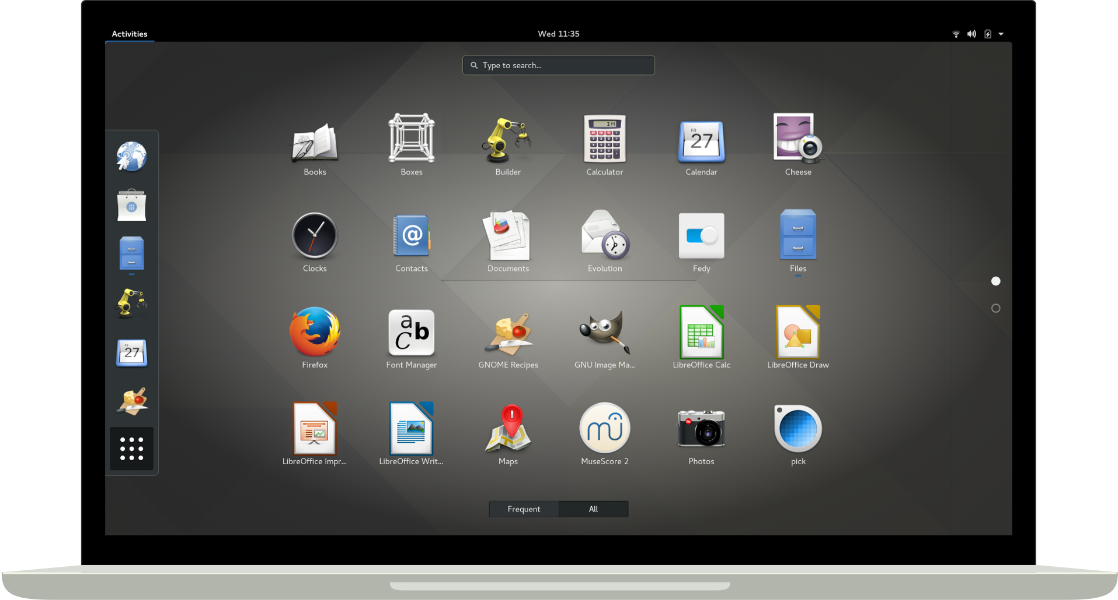

Slide 22
rpm - Redhat\CentOS
RPM Package Manager (rpm)
Useful arguments
-i (install), -U (upgrade), -e (erase), and -q (query)
Query all packages
rpm -qa
rpm -qa | grep strace
List files in a package
rpm -ql strace
Not often used alone
Dependency hell
rpm -q --whatrequires strace

Slide 23
dpkg - Debian
Package manager for Debian
Useful arguments
-i (install), -r (remove)
Query all packages
dpkg -l
List files in a package
dpkg -L strace
Reconfigure - dpkg-reconfigure
apt install slapd
dpkg-reconfigure slapd

Slide 24
High-Level Package Managers

Slide 25
High-Level Package Managers
Meta Packaging system
apt - Debian/Ubuntu
dnf - Fedora/Redhat/CentOS (formerly used yum)
Simplifies
Finding packages
Automates installation,updating and OS upgrading
Handle inter-package dependencies
Requires a significant amount of infrastructure
Maintainers
Web-servers
Certificates
Distributed
Anyone can host a repository

Slide 26
High-Level Package Managers
Red Hat Network
Commercial
Offers site-wide system management
Works with the proprietary Satellite Server
Supports apt and dnf
APT*
Better documentation
Vibrant community
rpm support (alien)
dpkg + .deb
dnf
RHEL\CentOS
RPMs
“Enterprise”
*preferred

Slide 27
Package repositories
HTTP or FTP based
https://mirrors.ocf.berkeley.edu/ubuntu
Supports a release
18.04 bionic or 9.1 stretch
Package versions are frozen
4.15 Kernel
Security updates - Backported
Component
Subset of software
main, free, non-free, contrib
Debian Free Software Guidelines (DFSG)
https://www.debian.org/social_contract.en.html
GPL vs non-GPL
Architecture
i686, amd64, and arm64

Slide 28
Package repositories
Individual packages
Example: python3 (python3.6)
Make up components
Architecture-specific
Versioned independently
“extras”
Multiverse and universe
Non-free components
Manually added
Examples
Oracle Java, and NVIDIA

Slide 29
/etc/apt/sources.list
#Basic
deb http://httpredir.debian.org/debian buster main contrib non-free
#Backports
deb http://httpredir.debian.org/debian buster-backports main contrib non-free
apt search wireguard

Slide 30
Backports
Backports are packages taken from the next Debian release
Recompiled for usage on Debian stable
Easily upgraded
Recommended to only select single backported packages that fit your needs
https://backports.debian.org/

Slide 31
Advanced Packaging Tool (APT)
Mature
First released in 1999 as part of Debian 2.1 (Slink)
Supports updates and upgrades
Moving from one release to another.
18.04 -> 20.04
yum does not support release upgrades, but dnf does
Distros contain many metapackages (yum calls them groupinstalls)
linux-image-generic
xfce-desktop
build-essential
Includes low level utilities
apt-file
apt-cache

Slide 32
Commands
apt update # apt downloads lists # from repos defined in /etc/apt/sources.list apt search neovim # Look for NeoVIM apt show neovim # Show neovim information apt-cache madison neovim # Show Versions apt-cache madison gcc # Show GCC versions apt -s install gcc=4:7.3.0-3ubuntu2 # Downgrade apt-cache depends neovim # Show neovim depencies apt-cache stats apt-cache policy gcc # Displays preferences

Slide 33
Debian Packaging
https://www.debian.org/doc/manuals/packaging-tutorial/packaging-tutorial.en.pdf

Slide 34
What is Debian?
GNU/Linux distribution
coreutils: https://www.maizure.org/projects/decoded-gnu-coreutils/
gcc
1st major distro developed “openly in the spirit of GNU”
Non-commercial, built collaboratively by over 1,000 volunteers
3 main features:
Quality – culture of technical excellence We release when it’s ready
Freedom – devs and users bound by the Social Contract Promoting the culture of Free Software since 1993
Independence – no (single) company babysitting Debian And open decision-making process (do-ocracy + democracy )
Amateur in the best sense: done for the love of it

Slide 35
Debian Packages
.deb files (binary packages)
A very powerful and convenient way to distribute software to users
One of the two most common package formats (with RPM)
Universal:
30,000 binary packages in Debian
most of the available free software is packaged in Debian!
For 12 ports (architectures), including 2 non-Linux (Hurd; KFreeBSD)
Also used by 120 Debian derivative distributions

Slide 36

.deb Packaging Format
.deb file: an ar archive
$ ar tv wget_ 1 .12 -2.1 _i386 . deb
debian-binary: version of the deb file format, "2.0\n"
control.tar.gz: metadata about the package
control, md5sums, (pre|post)(rm|inst), triggers, shlibs, . . .
data.tar.gz: data files of the package

Slide 37
.deb Packaging Format
You could create your .deb files manually http://tldp.org/HOWTO/html_single/Debian-Binary-Package-Building-HOWTO/
But most people don’t do it that way

Slide 38
Tools
A Debian (or Ubuntu) system (with root access)
Some packages:
build-essential: has dependencies on the packages that will be assumed to be available on the developer’s machine (no need to specify them in the Build-Depends: control field of your package)
includes a dependency on dpkg-dev, which contains basic Debian-specific tools to create packages
devscripts: contains many useful scripts for Debian maintainers
Many other tools are available, such as debhelper, cdbs, quilt, pbuilder, sbuild, lintian, svn-buildpackage, git-buildpackage, . . .
Install them when you need them.

Slide 39
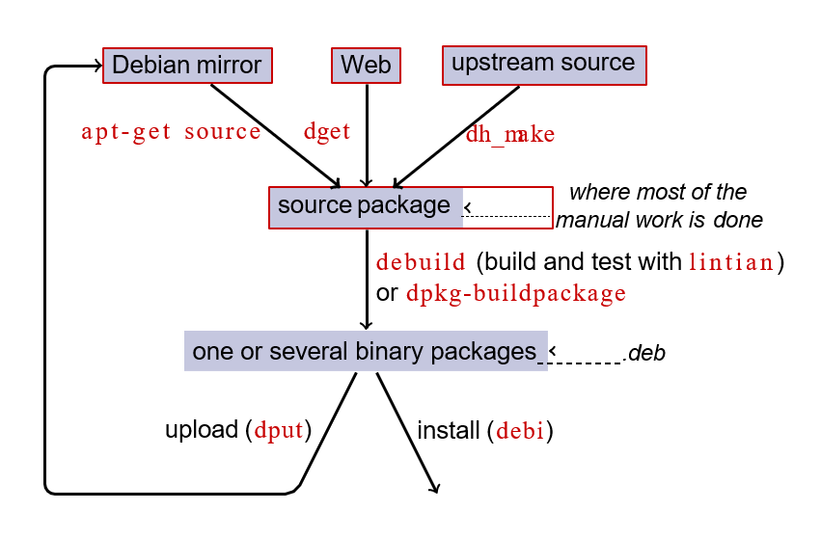
Workflow

Slide 40
Rebuilding dash
Install packages needed to build dash, and devscripts sudo apt-get build-dep dash (requires deb-src lines in /etc/apt/sources.list) sudo apt-get install --no-install-recommends devscripts fakeroot
Create a working directory, and get in it: mkdir /tmp/debian-tutorial ; cd /tmp/debian-tutorial
Grab the dash source package apt-get source dash (This needs you to have deb-src lines in your /etc/apt/sources.list)
Build the package cd dash-* debuild -us -uc (-us -uc disables signing the package with GPG)
Check that it worked There are some new .deb files in the parent directory
Look at the debian/ directory That’s where the packaging work is done
Notes:
-us
Do not sign the source package.
-uc
Do not sign the .changes file.

Slide 41
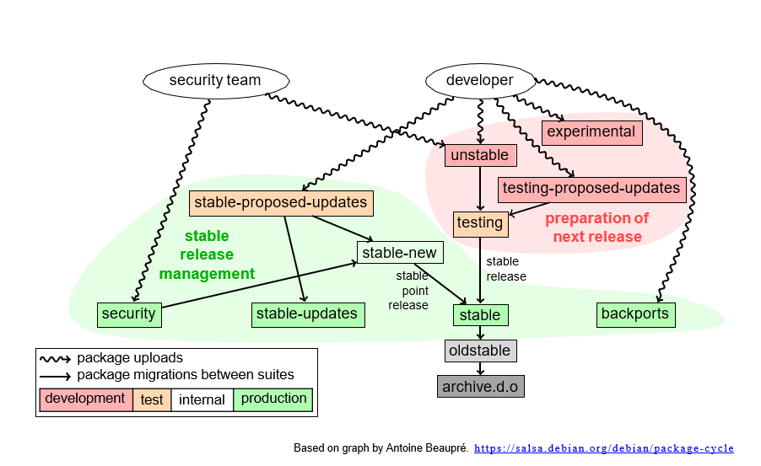
Workflow

Slide 42
Testing
The package has been in "unstable" at least for 2-10 days (depending on the urgency of the upload).
The package has been built for all the architectures which the present version in testing was built for.
Installing the package into testing will not make the distribution more uninstallable.
The package does not introduce new release critical bugs

